Slide 1
What is DNA?
Review

Slide 2
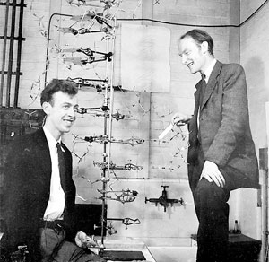
Who?
James Watson and Francis Crick in 1953 discovered the structure of DNA
They had help from Maurice Wilkins and Rosalind Franklin
X-Ray Crystallographers
Helped to determine the Double Helix Structure

Slide 3
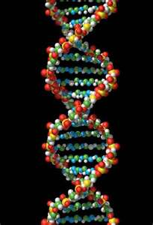
Deoxyribonucleic Acid
Hereditary material of organisms
Located in the nucleus (eukaryotes) or nucleoid region (prokaryotes)
Some DNA is found in mitochondria and chloroplasts too

Slide 4
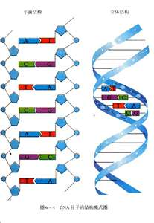
Repeating Segments
DNA is made up of repeating units called nucleotides
Three Parts
Sugar (ribose)
Phosphate group (PO4)
Nitrogen Base
Double stranded – helix
Sugar/Phosphate backbone
Connected by nitrogen bases
Hydrogen bonds

Slide 5
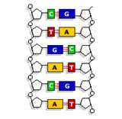
Nitrogen Bases
Adenine
Thymine
Guanine
Cytosine
Complementary – pair up
A – T
G – C

Slide 6
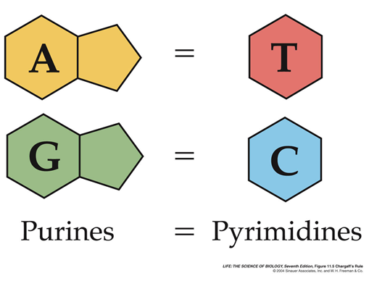
Bases A and G have a double-ring structure and are classified as purines.
Bases T and C have a single-ring structure and are classified as pyrimidines.

Slide 7
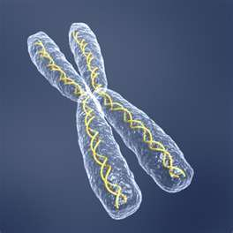
DNA can replicate!
Each strand serves as a template in making new strands
Important part of cell division (interphase)
Normally DNA is tightly compacted as a chromosome
Unwinds so it can be copied during replication

Slide 8
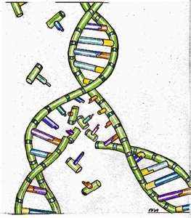
DNA Replication
DNA must be unzipped
Breaks the hydrogen bonds between nitrogen bases
Each strand serves as a template for a new strand
Enzymes (DNA polymerase) build new strands by attaching complementary nitrogen bases
Based on the template

Slide 9
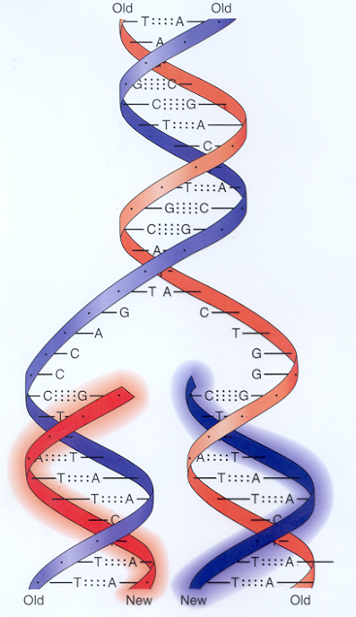

Slide 10
You try it…
DNA strand:
ATTCCGGTAGGCTTGATTCCAGTAAT
Complementary strand:
TAAGGCCATCCGAACTAAGGTCATTA

