Slide 1
Cell Reproduction Vocab Quizzy! Part 1
You are welcome ☺

Slide 2
Question 1
_________________ is considered the division of the nucleus
A- Cytokenesis
B- Mitosis
C- Meiosis
D- Chromatid

Slide 3
Question 2
Cells go through a series of events known as the ________ _________ as they grow and divide
A- Cell Cycle
B- Chromosome
C- Gene
D- Alleles

Slide 4
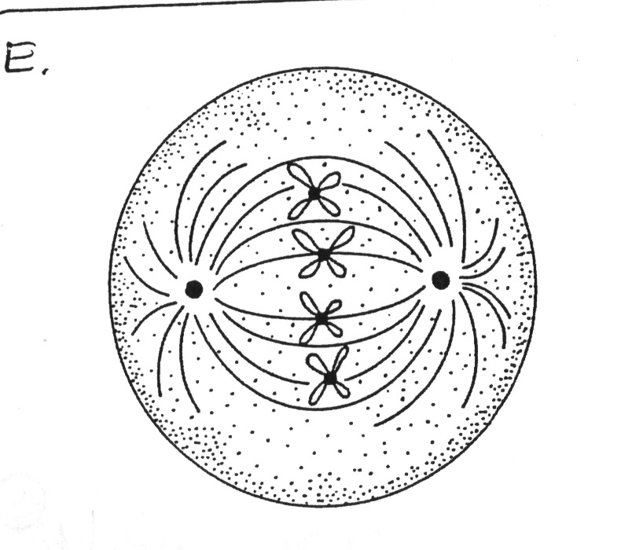
Question 3
The ___________ is the “fanlike” system of microtubules that will help to separate the duplicate chromosomes
A- Centromere
B- Centrioles
C- Spindle
D- Gene

Slide 5
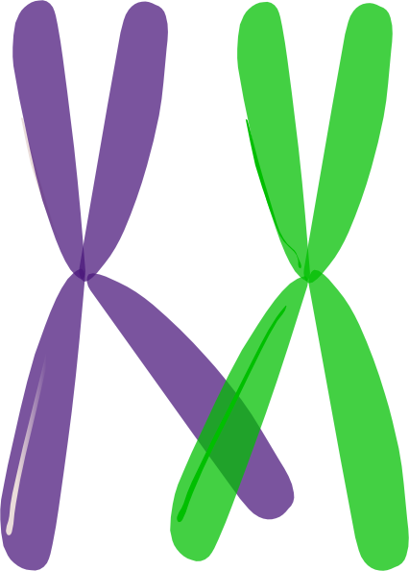
Question 4
Homologous chromosomes are ___________.....
A- Similar in size, shape and genes
B- Completely different
C- Different in the type of gene
D- Quick to separate

Slide 6
Question 5
Asexual reproduction requires ____ parent(s), Sexual reproduction requires _____ parent(s).
A- 1,1
B- 2,2
C- 3, 1
D- 1, 2

Slide 7
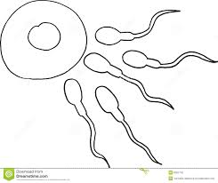
Question 6
Gametes are____________...
A- Body Cells
B- Sex Cells
C- Brain Cells
D- Skin Cells

Slide 8
Question 7
A cell that contains two or both sets of chromosomes (2n) is said to be__________
A- Haploid
B- Heterozygous
C- Germ
D- Diploid

Slide 9
Question 8
____________ is the process in which the number of chromosomes per cell is cut in half through separation of homologous chromosomes in a diploid cell. This process happens in creating sex cells.
A- Mitosis
B- Zygote
C- Meiosis
D- Chromatin

Slide 10
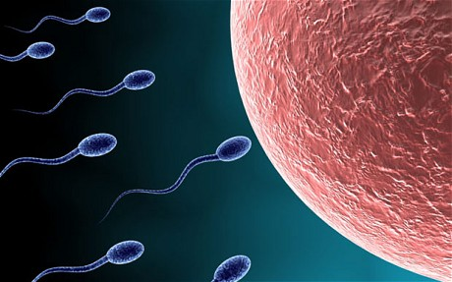
Question 9
The sperm cell is the ________ sex cell
A- Male
B- Female
C- Bird
D- Bacteria

Slide 11
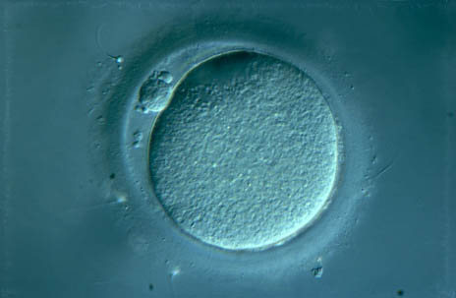
Question 10
The female germ cell is also called a(n)________ cell
A- Sperm
B- Zygote
C- Egg
D- Heart

